Slide 1



SecureComponentManager
SecureComponentManager is a powerful cybersecurity tool designed to protect your systems and data from threats. Discover how it can revolutionize your security measures.
~Team Nothing

Slide 2


Introduction to SecureComponentManager
Sophisticated software solution which ensures the security of an organization's infrastructure by overseeing the monitoring, and protecting the software components.

Slide 3

Overview of the Tool and Its Purpose
SecureComponentManager offers a comprehensive approach to security management
It excels in integrating with various security tools and protocols, providing a centralized hub for managing and coordinating different security mechanisms.
It can handle a large number of components and adapt to evolving security needs, making it suitable for both small businesses and large enterprises.

Slide 4
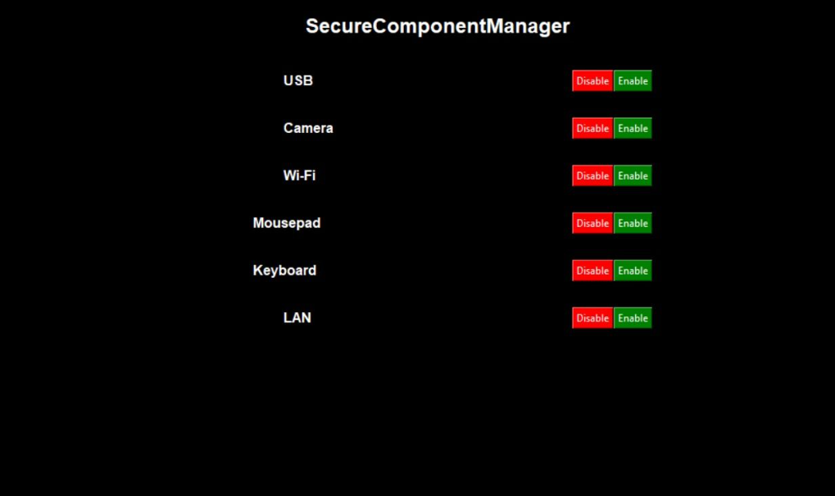
Suggestive Interface
This simplifies the overall security architecture and reduces the complexity of maintaining multiple, disparate security tools.

Slide 5
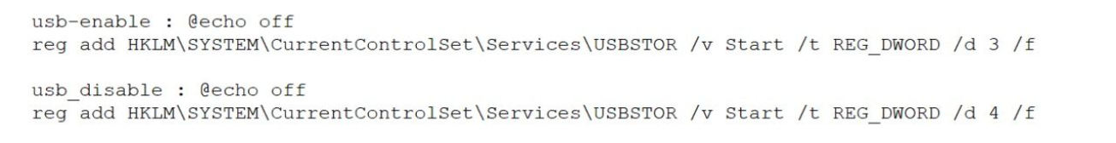
Implementation of Code Samples
USB Code Sample:
Here is the sample code Batch File for the USB component.

Slide 6
Features and Benefits of Using SecureComponentManager
Advanced Threat Protection
Real-Time Monitoring
User-Friendly Interface
Mitigate even the most sophisticated cyber threats with SecureComponent Manager’s state-of-the-art technology.
Constantly monitor your systems and network for any suspicious activities, providing you with real-time alerts and notifications.
Enjoy a user-friendly interface that streamlines your security operations and enables effortless management of your security systems.

Slide 7

Conclusion
SecureComponentManager is a multifaceted solution that is purpose-built for overseeing and managing the security of software components in a comprehensive, integrated, and customizable manner.

